Slide 1
DIPARTIMENTO DI INGEGNERIA ELETTRICA E TECNOLOGIE DELL’INFORMAZIONE
SCUOLA POLITECNICA E DELLE SCIENZE DI BASE
LAUREA MAGISTRALE IN INGEGNERIA DELL’AUTOMAZIONE E ROBOTICA
Analysis and Control of 1-DOF roll dynamics of a ship with active fins
Mario Valentino

Slide 2

Outline
Motivations
Mathematical model
Analysis
Equilibrium points
Structural stability
Physical interpretation
Synthesis
Control specifications
Robustness to disturbance and uncertainties
Conclusions
2/12

Slide 3

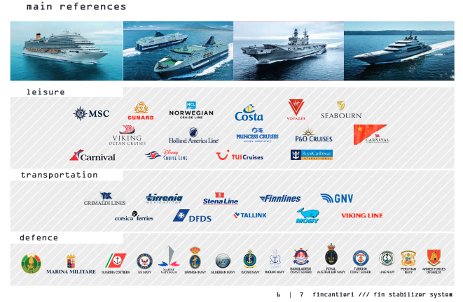
Motivations
3/12

Slide 4
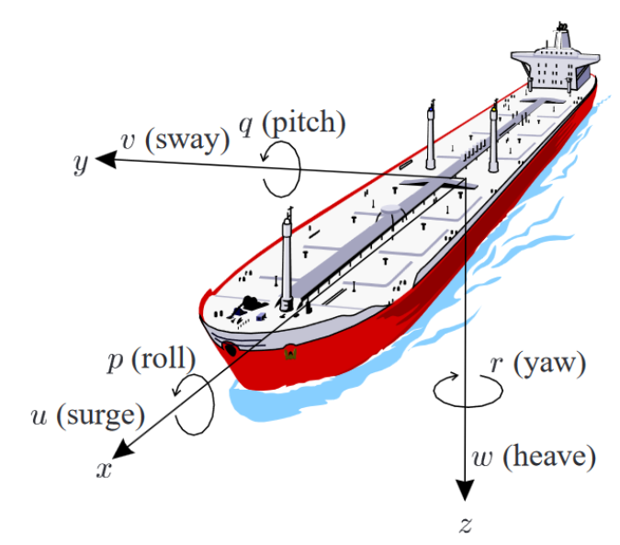
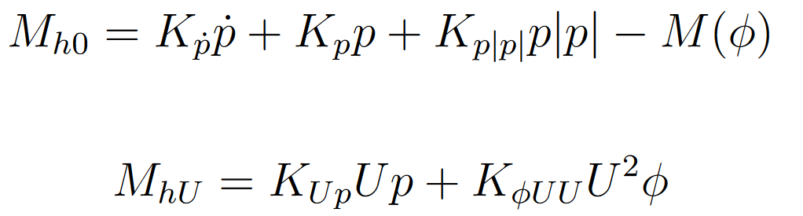
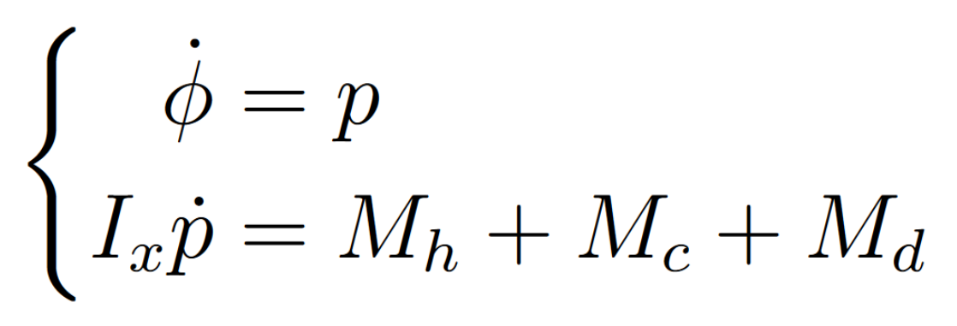
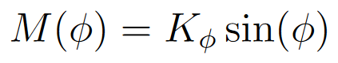
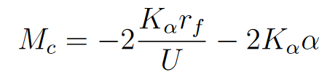
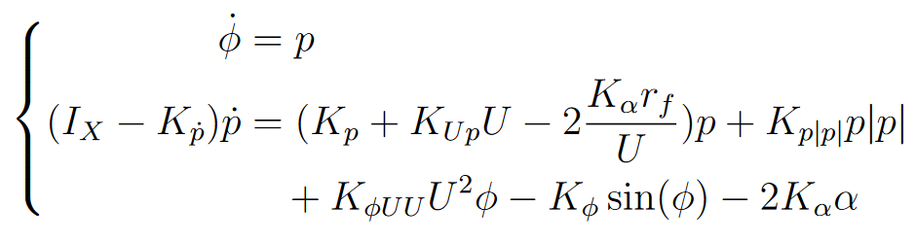
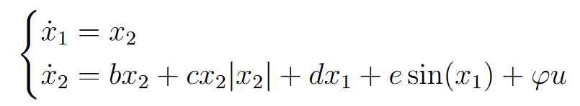
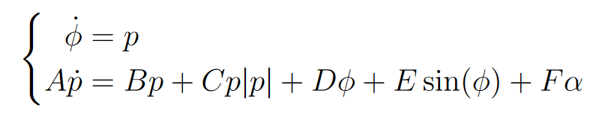
Mathematical Model
Tristan Perez and Mogens Blanke. “Ship roll damping control”. In: Annual Reviews in Control 36.1 (2012), pp. 129–147. issn: 1367-5788. doi: https://doi .org /10.1016/j.arcontrol.2012.03.010. url: https://www.sciencedirect.com/science/article/pii/S1367578812000119.
4/12

Slide 5
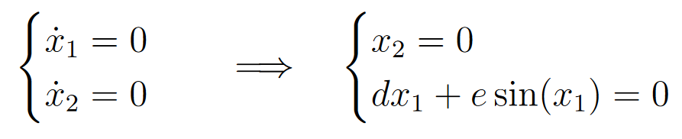
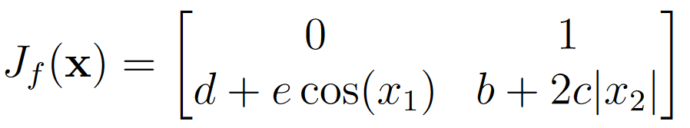
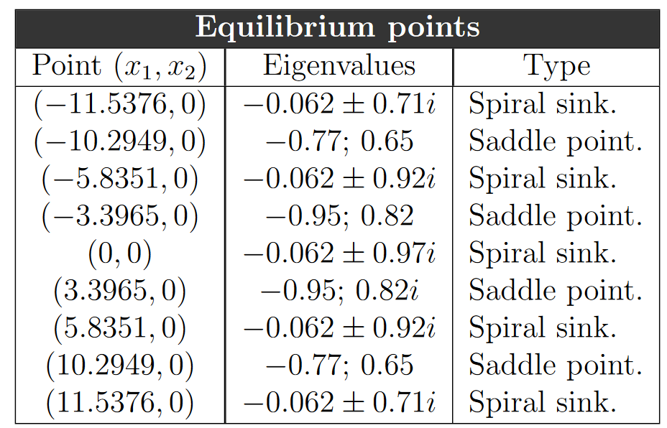
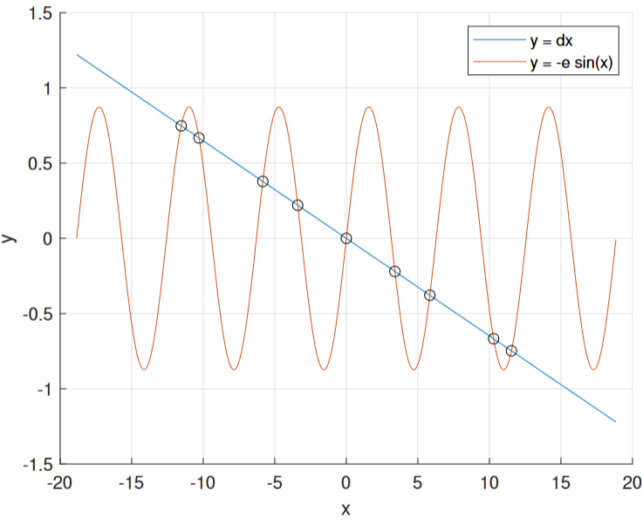
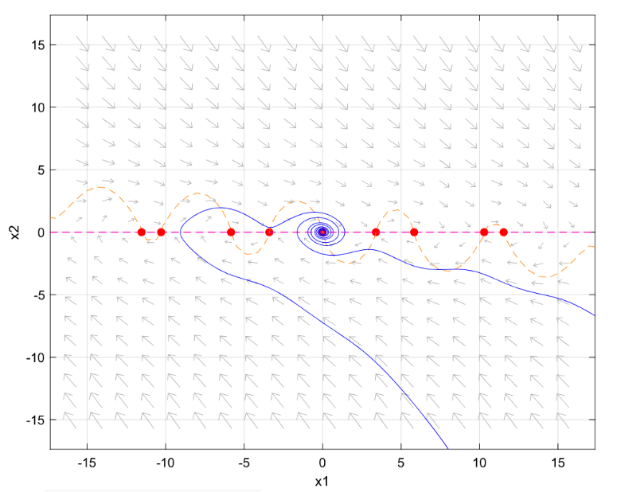
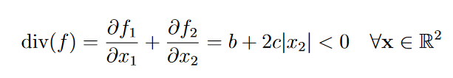
Analysis: equilibrium points
5/12

Slide 6
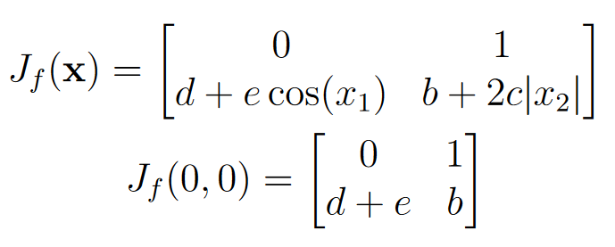
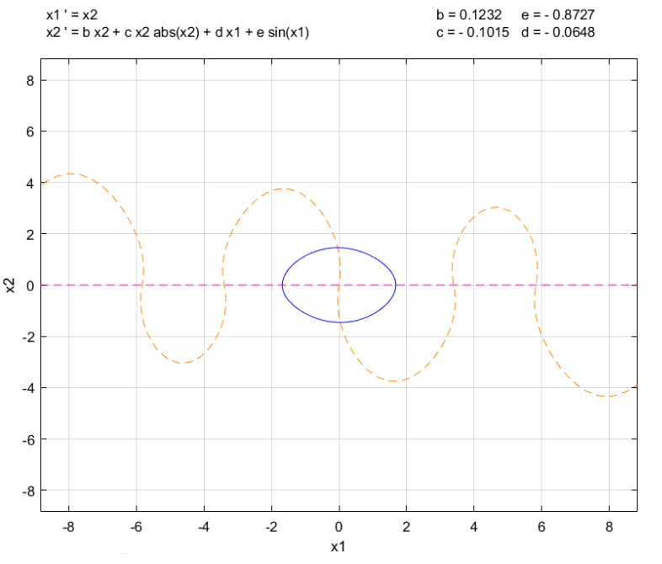
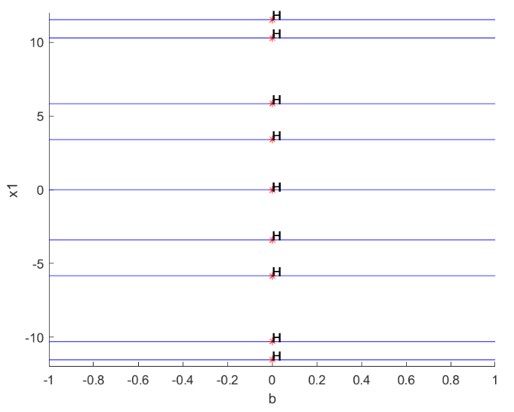
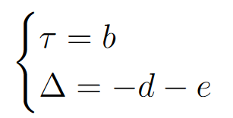
Analysis: structural stability
6/12

Slide 7
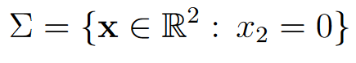
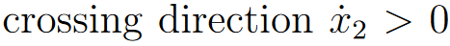
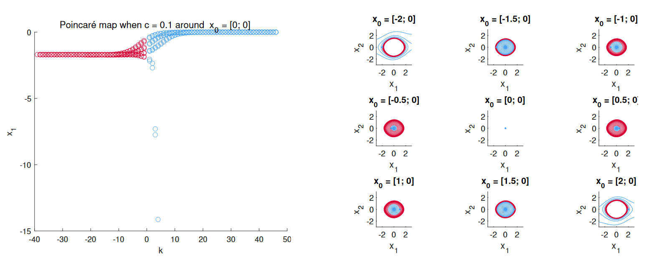
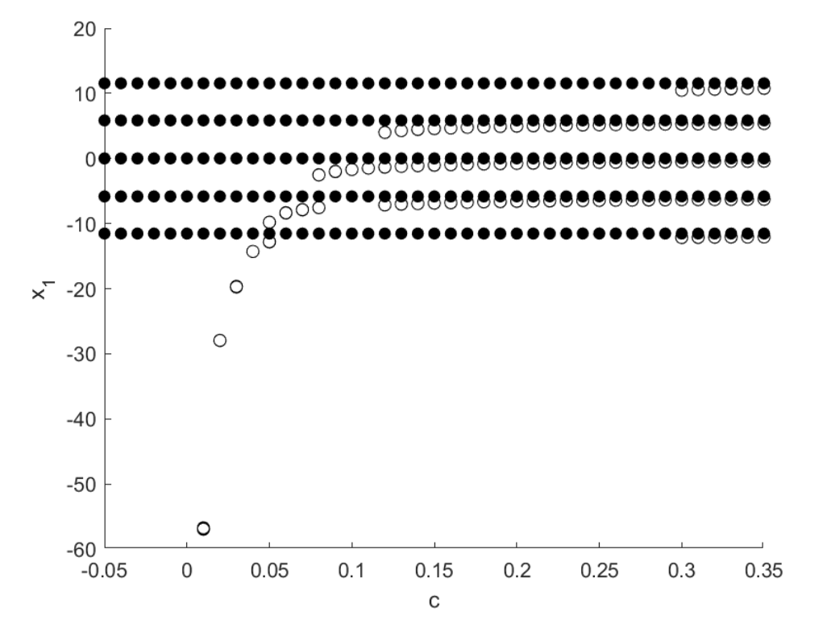
Analysis: structural stability
7/12

Slide 8
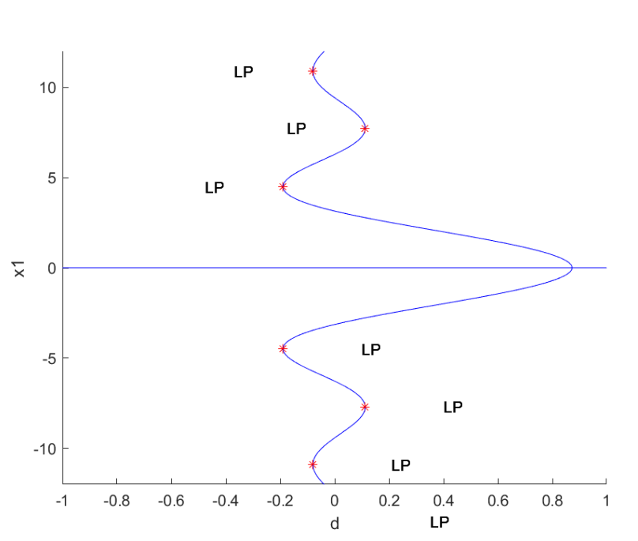
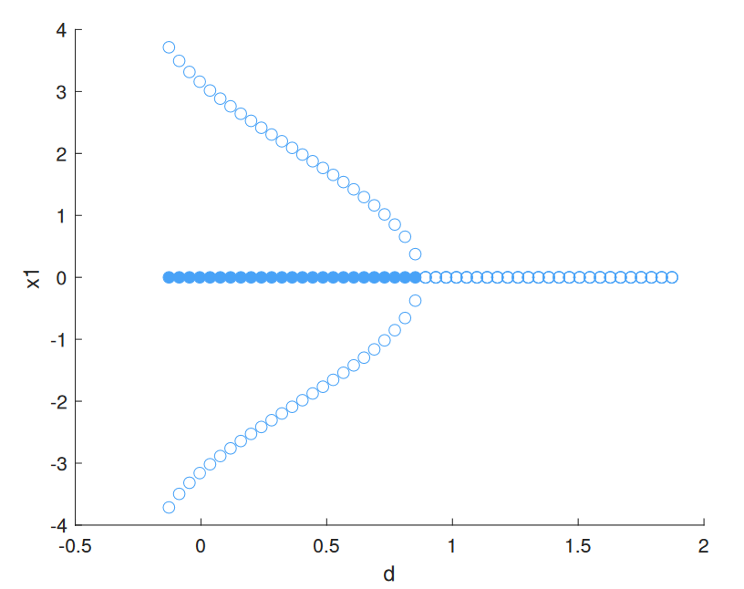
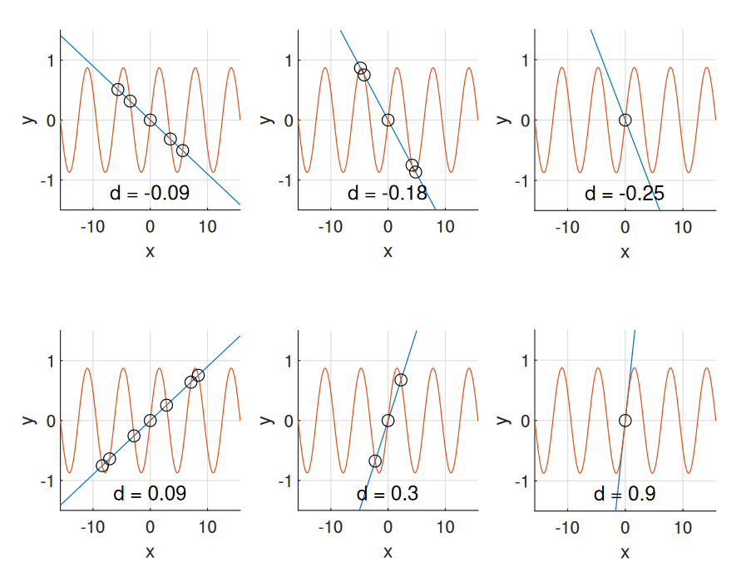
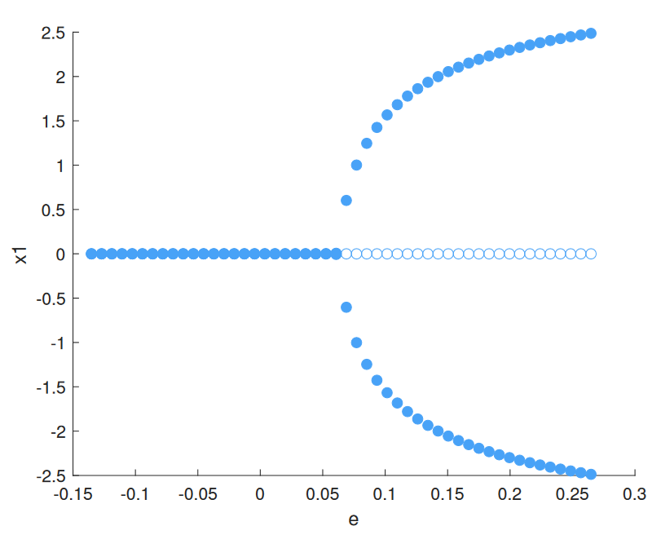
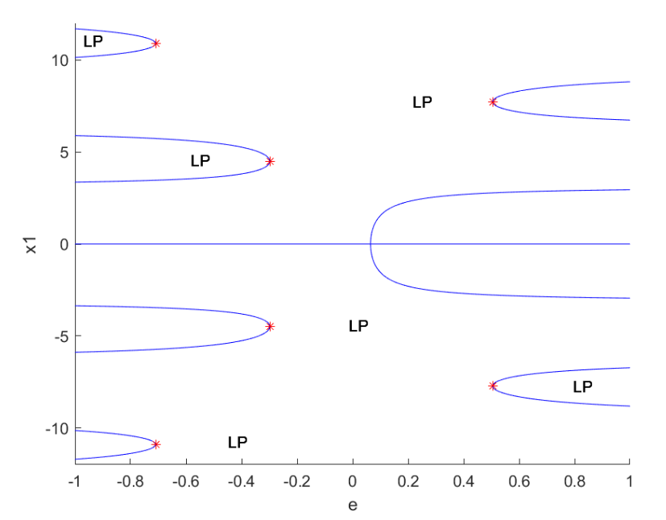
Analysis: structural stability
8/12

Slide 9
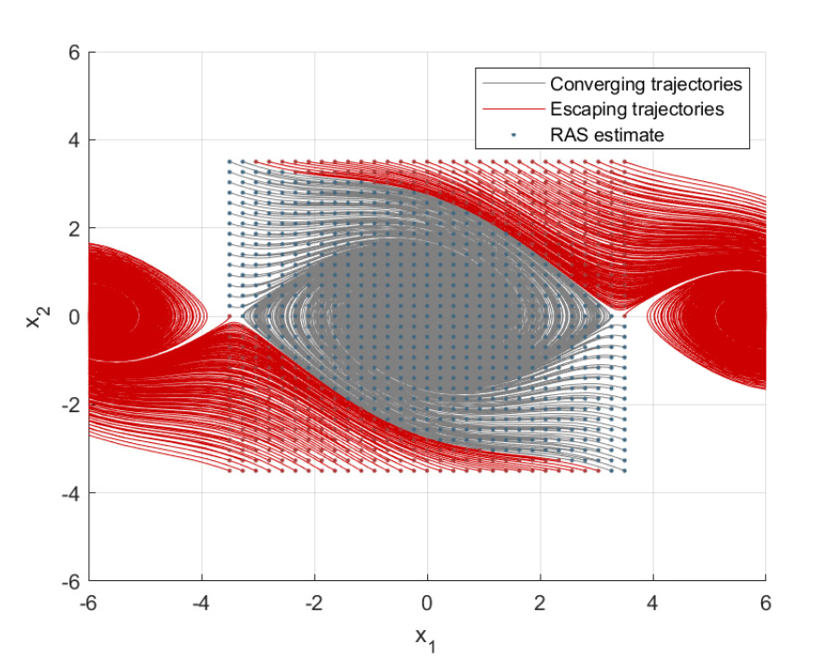
Analysis: physical interpretation
9/12

Slide 10
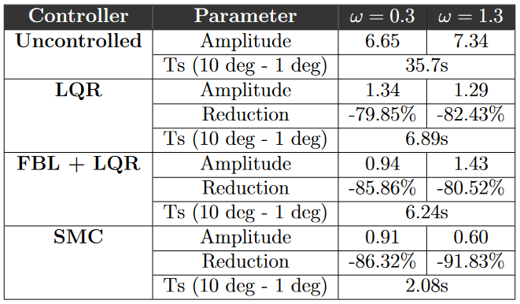
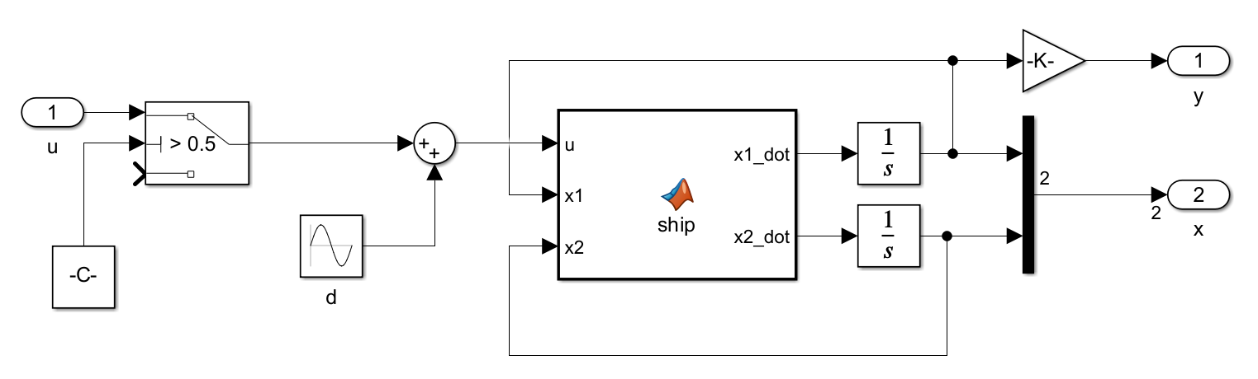
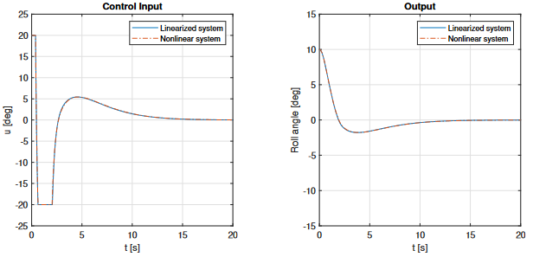
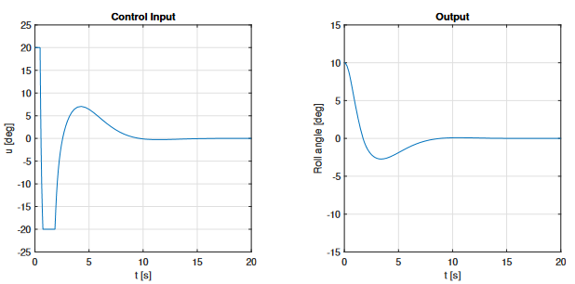
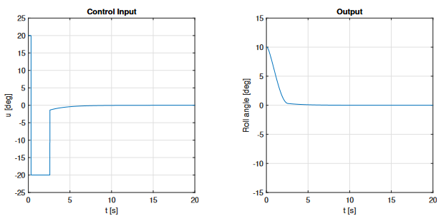
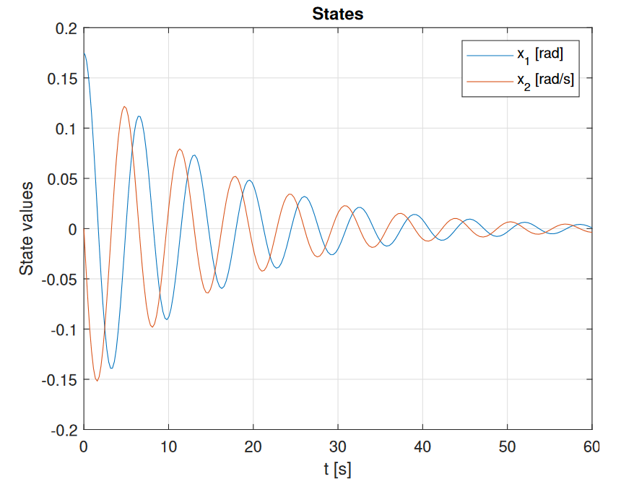
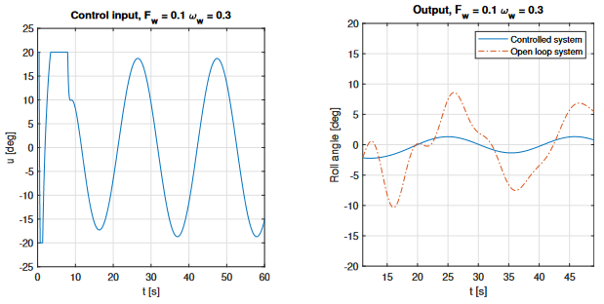
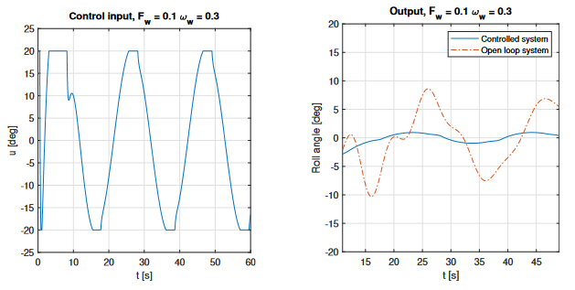
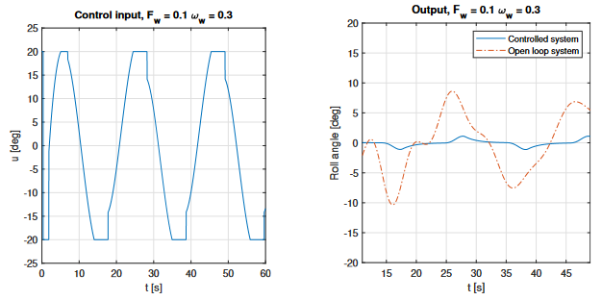
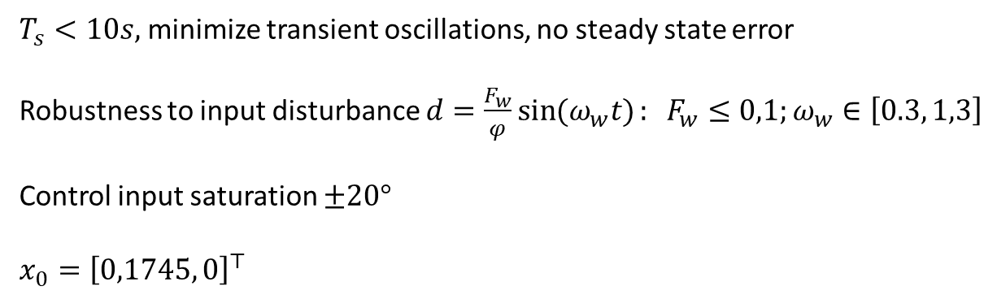
Synthesis
$T_{s}<10s,$ minimize transient oscillations, no steady state error
Robustness to input disturbance $d=\frac{F_{w}}{φ}\sin{(ω_{w}t)}: F_{w}≤0,1;ω_{w}∈\left[0.3, 1,3\right]$
Control input saturation $±20°$
$x_{0}={\left[0,1745, 0\right]}^{⊤}$
LQR
FBL
SMC
Uncontrolled
10/12

Slide 11
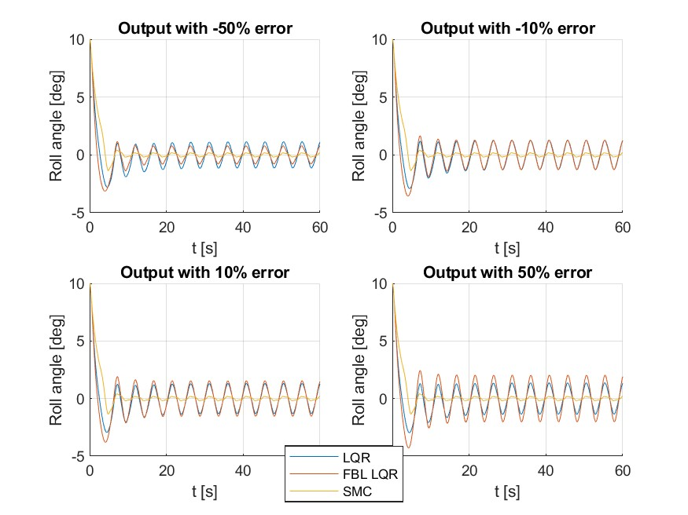
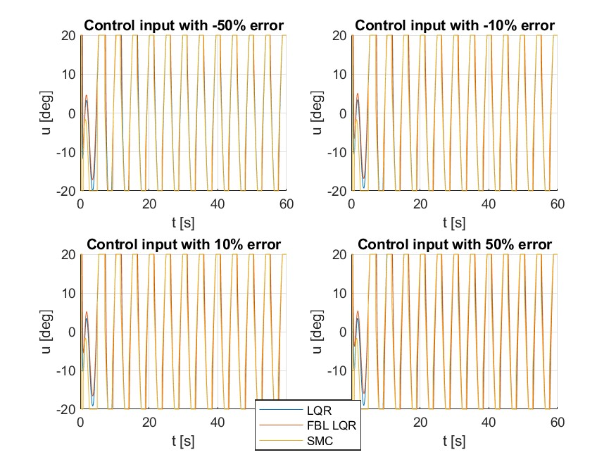
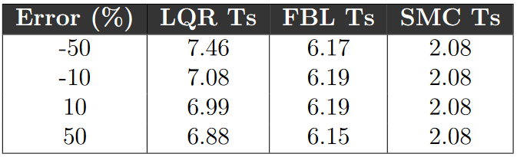
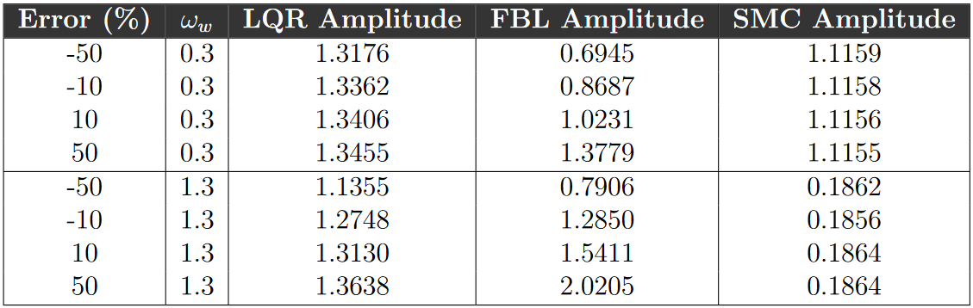
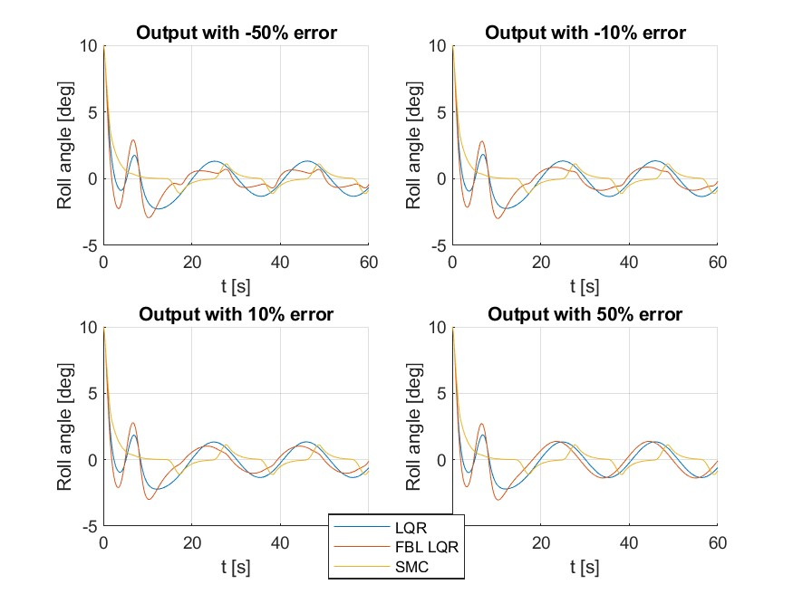
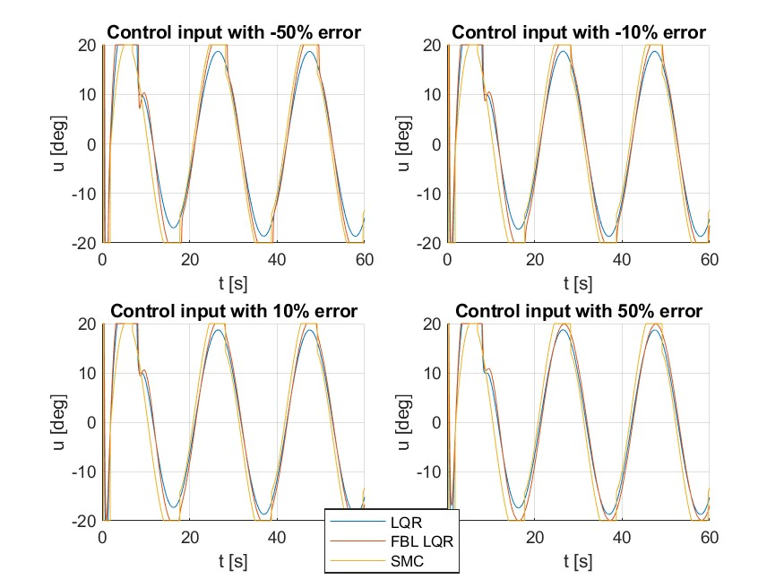
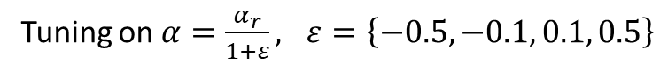
Synthesis: parameters uncertainties
Tuning on $α=\frac{α_{r}}{1+ε}, ε=\left\{−0.5, −0.1, 0.1, 0.5\right\}$
11/12

Slide 12
Conclusions and further developments
Analyzed and interpreted the results of the mathematical model on the physical system Phase Plane analysis, Poincaré maps, MATCONT
Developed and tested effective control strategies LQR, FBL + LQR, SMC
It depends!
Does SMC work better than LQR or FBL?
Further developments:
Include actuator dynamics
Higher DOF model
Improved disturbance model
12/12

Slide 13
Mathematical Model
Due to pressure change: proportional to the roll acceleration
Restoring terms due to buoyancy and gravity
Linear friction term (skin friction)
Nonlinear damping term
Change of the parameters due to vessel velocity
Tristan Perez and Mogens Blanke. “Ship roll damping control”. In: Annual Reviews in Control 36.1 (2012), pp. 129–147. issn: 1367-5788. doi: https://doi .org /10.1016/j.arcontrol.2012.03.010. url: https://www.sciencedirect.com/science/article/pii/S1367578812000119.

Slide 14
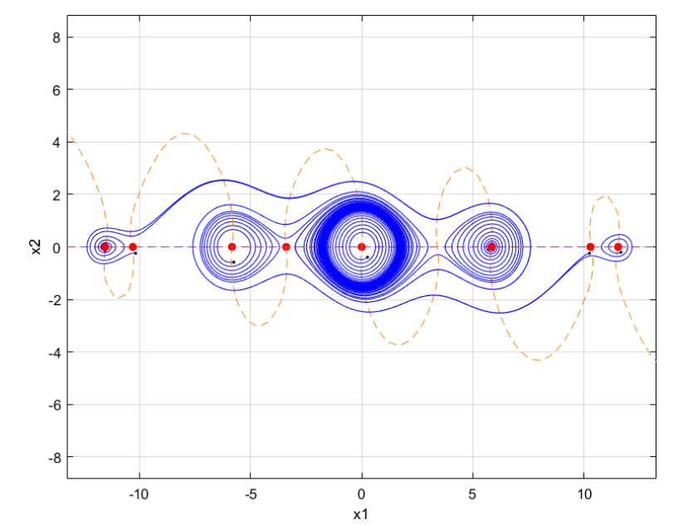
Analysis: structural stability
14/12

Slide 15
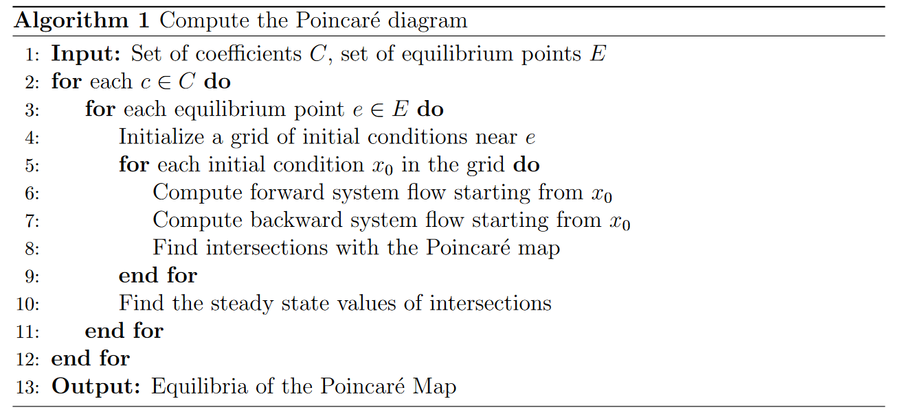
Analysis: structural stability
15/12

Slide 16
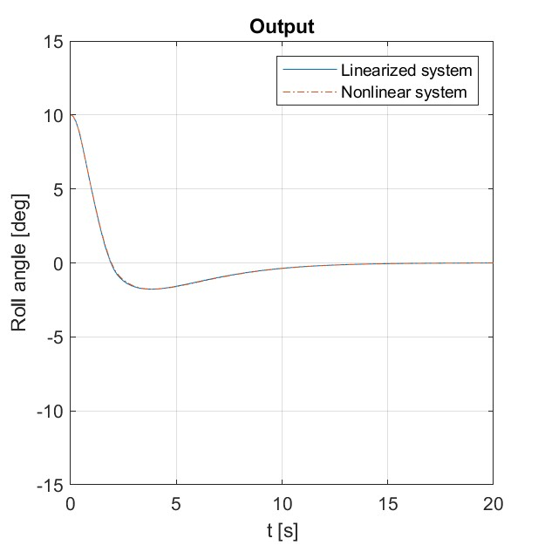
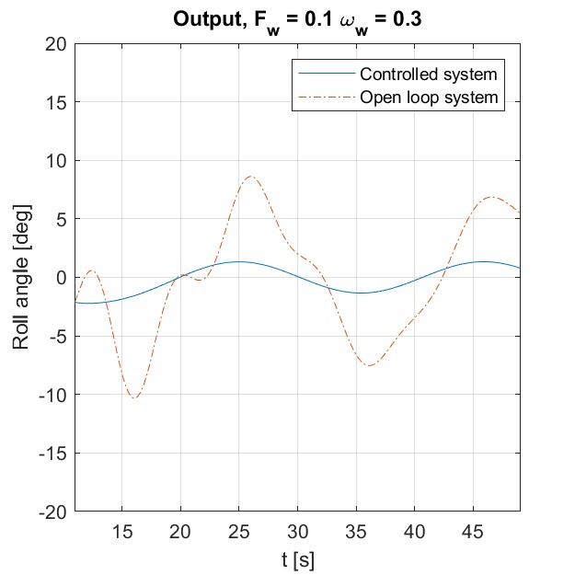





Synthesis: LQR
16/12

Slide 17








Synthesis: FBL + LQR
17/12

Slide 18







Synthesis: SMC
18/12

